Slide 1
HEAB / WISSIS
Higher Educational Aids Board
Wisconsin Student Support Information System
April 13, 2023

Slide 2
About You
Peter Zammuto
Sherrie Nelson
Grant Administrator
Admin Policy Advisor
WI Higher Educational Aids Board
Peter.Zammuto@wisconsin.gov
WI Higher Educational Aids Board
Sherrie.Nelson@wisconsin.gov

Slide 3
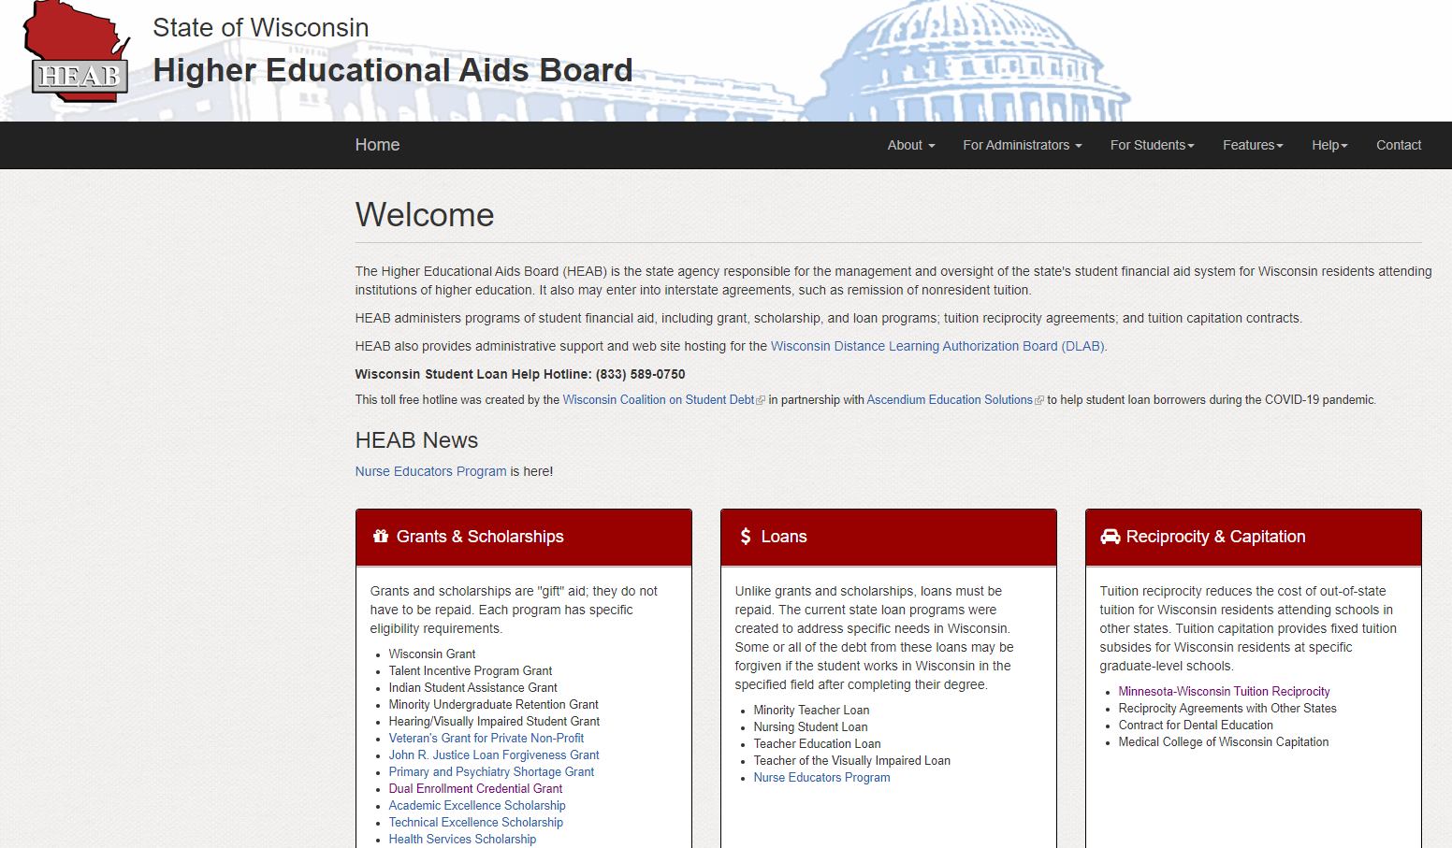
heab.state.wi.us
Grants
Scholarships
Loans
Tuition Reciprocity
Tuition Capitation

Slide 4
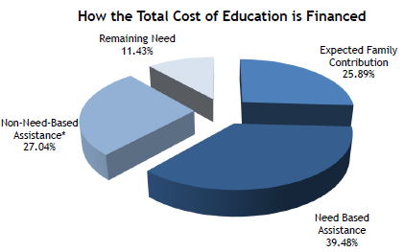
WISSIS – What is it and why is it important?
WISCONSIN
STUDENT
SUPPORT
INFORMATION
SYSTEM
*May also be fulfilling EFC
Support Current Funding levels
Show Need For additional Funding

Slide 5
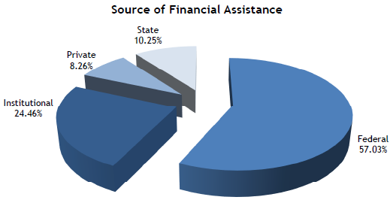
Financial Assistance - Source

Slide 6
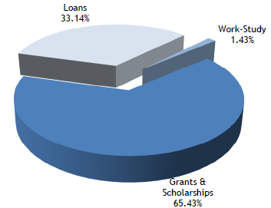
Financial Assistance - Type

Slide 7
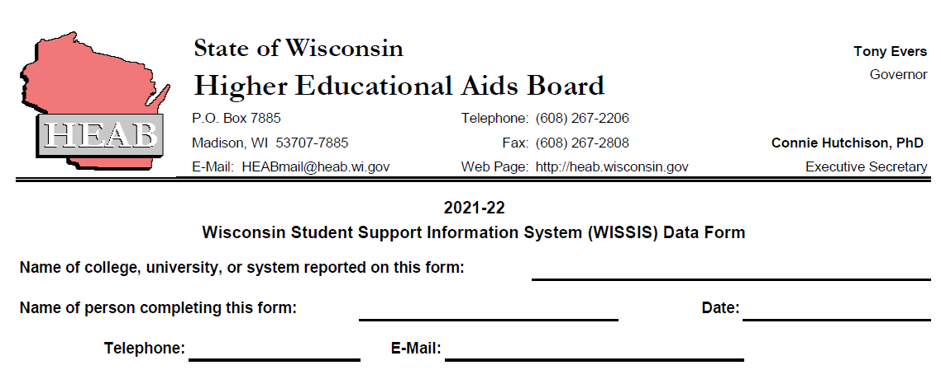
Survey Says…

Slide 8
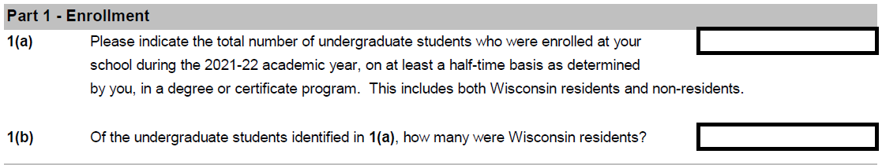
Survey Part 1
1(a)
At Least 1/2 time basis + In a degree or Certificate program
1(b)
Wisconsin Residents

Slide 9
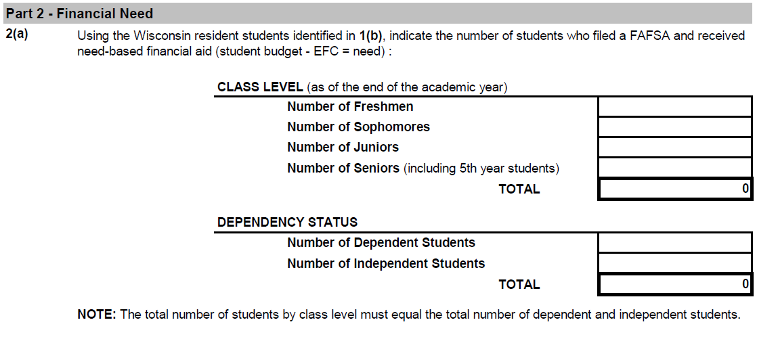
Survey Part 2
=

Slide 10
2(b) and 2(c) … adding it up
2(b) | Using the students identified in 2(a), indicate the Total Cost of Education.
 | Add the individual total cost of education figures for each dependent and independent student. Add the total of dependent and independent students to obtain the Total Cost of Education for all students.
 | Dependent Students (costs for all dependent students combined)
 | Independent Students (costs for all independent students combined)
 | Total Cost of Education (dependent and independent student costs combined). |  |  |  |  |  |  | $ -
2(c) | Using the students identified in 2(a), indicate the total Expected Family Contributions (EFC).
 | Add the individual EFC's for each dependent and independent student. Add the totals for dependent and independent students to obtain the EFC Total for all students.
 | Dependent Students (EFC's for all dependent students combined)
 | Independent Students (EFC's for all independent students combined)
 | Total EFC's (dependent and independent EFC's combined) |  |  |  |  |  |  | $ -
Total Cost of Education
Total Expected Family Contribution

Slide 11
Part 3 Financial Assistance
3(a) Need Based
3(b) Non-Need Based
Include all aid awarded and accepted,
even if aid was not disbursed.
Include any aid you are aware of that was paid directly to students.
QUESTIONS?

Slide 12
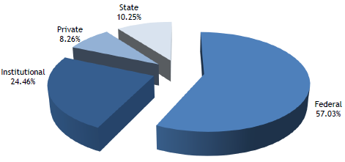
4 Sources of Financial Assistance
Federal
State
Institutional
Private

Slide 13
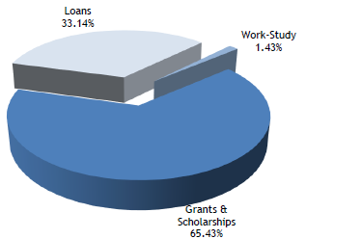
3 Types of Financial Assistance
Loans
Work-Study
Grants & Scholarships

Slide 14
Reporting the Aid
 |  |  |  | Source | Type
 |  |  |  | federal
 |  |  |  | state | grant
 |  |  |  | institution | loan | Number of Awards | Total Amount
 |  |  |  | private | employment
ACG (Academic Competitiveness Grant) |  |  |  | Fed | Grant |  | $ -
BIA (Bureau of Indian Affairs Grants) |  |  |  | Fed | Grant |  | $ -
Fed Work Study |  |  |  | Fed | Work |  | $ -
Fund for WI Scholars (UW and Tech Only) |  |  |  | Pri | Grant |  | $ -
Lawton Grant (UW Only) |  |  |  | State | Grant |  | $ -
Need Based Inst Emp |  |  |  | Inst | Emp |  | $ -
Need Based Inst Grants |  |  |  | Inst | Grant |  | $ -
Need Based Inst Loans |  |  |  | Inst | Loan |  | $ -
Need Based Private Grants / Scholarships |  |  |  | Pri | Grant |  | $ -
Pell Grant |  |  |  | Fed | Grant |  | $ -
Direct Subsidized Loan (Stafford) |  |  |  | Fed | Loan |  | $ -
SEOG (Supplemental Educational Opportunity Grant) |  |  |  | Fed | Grant |  | $ -
Numbers only
  No Spaces
  Do enter N/A
Do not include aid administered by HEAB
Do include aid that your institution is required to match to HEAB award
  AES
  TES
  Veterans Grant Private Non-Profit

Slide 15
Aid not listed
Write in Award Type and indicate Source and Type.
Award | Souce | Type | Number of Awards | Total Amount
 |  |  |  | $ -
 |  |  |  | $ -
 |  |  |  | $ -
 |  |  |  | $ -
 |  |  |  | $ -
TOTAL |  |  | 0 | $ -
Each Aid section has a “Write in” section:
List Source
Federal
State
Institutional
Private
List Type
Loans
Work-Study
Grants & Scholarships
What if I don’t know the Source or Type?
HEAB can help!
QUESTIONS?

Slide 16


Non-Aid utilized to fulfill EFC … 3(c)
 | This information is not collected.
 | Although this information is not collected, the estimated number of Wisconsin resident students who utilize some non-need aid to fulfill EFC:
 |  |  | %
 |  |  |  |  |  | Number | Total
 | This information is collected (add additional aid types as needed): |  |  |  |  | of Awards | Amount
 |  | Alternate Loans
 |  | PLUS Loans
 |  |  |  |  | TOTALS: | 0 | $0
 | This information is not collected.
 | Although this information is not collected, the estimated number of Wisconsin resident students who utilize some non-need aid to fulfill EFC:
 |  |  | %
 |  |  |  |  |  | Number | Total
 | This information is collected (add additional aid types as needed): |  |  |  |  | of Awards | Amount
 |  | Alternate Loans
 |  | PLUS Loans
 |  |  |  |  | TOTALS: | 0 | $0
 | This information is not collected.
 | Although this information is not collected, the estimated number of Wisconsin resident students who utilize some non-need aid to fulfill EFC:
 |  |  | %
 |  |  |  |  |  | Number | Total
 | This information is collected (add additional aid types as needed): |  |  |  |  | of Awards | Amount
 |  | Alternate Loans
 |  | PLUS Loans
 |  |  |  |  | TOTALS: | 0 | $0
 | This information is not collected.
 | Although this information is not collected, the estimated number of Wisconsin resident students who utilize some non-need aid to fulfill EFC:
 |  |  | %
 |  |  |  |  |  | Number | Total
 | This information is collected (add additional aid types as needed): |  |  |  |  | of Awards | Amount
 |  | Alternate Loans
 |  | PLUS Loans
 |  |  |  |  | TOTALS: | 0 | $0
The utilization of non-need aid to fulfill or supplement EFC produces skewed WISSIS reporting.
Check the Box:
Not Collected
Estimate %
Collected
 | This information is not collected.
 | Although this information is not collected, the estimated number of Wisconsin resident students who utilize some non-need aid to fulfill EFC:
 |  |  | %
 |  |  |  |  |  | Number | Total
 | This information is collected (add additional aid types as needed): |  |  |  |  | of Awards | Amount
 |  | Alternate Loans
 |  | PLUS Loans
 |  |  |  |  | TOTALS: | 0 | $0

Slide 17
3(d): Check
Total Unmet Need (Normal)
 | Cost |  |  | $ -
 | - EFC |  |  | $ -
 | - Total Need-Based Aid |  |  | $ -
 | - Total Non-Need-Based Aid |  |  | $ -
 | = Unmet Need |  |  | $ -
Based on previous responses this table fills.
A negative unmet need could mean the reporting was inaccurate.
If you have an issue, HEAB will work with you to resolve.

Slide 18
All that data sent … What happens next?
All sector data is recorded:
  UW
  Private Non-Profit
  Technical Colleges
  Tribal Colleges
HEAB data recorded
All EFC Data
300 rows of Data
43 pages of Report

Slide 19
All that data sent … A peak under the “Hood”
Total Data - All Sectors |  |  | UW |  | Independent |  | Tribal |  | Tech |  | ALL
 |  |  | number | dollars | number | dollars | number | dollars | number | dollars | number | dollars
1(a) | Total number of undergraduates
G | enrolled at least half-time
G | in a degree or certificate program. |  | 129,523 |  | 40,252 |  | 515 |  | 68,683 |  | 238,973
1(b) | Wisconsin residents in 1(a). |  | 92,764 |  | 20,968 |  | 481 |  | 65,224 |  | 179,437
2(a) | Students in 1(b) who filed the FAFSA
 | and received financial aid.
 |  | Freshmen | 11,073 |  | 3,901 |  | 143 |  | 17,789 |  | 32,906
 |  | Sophmores | 9,183 |  | 3,150 |  | 71 |  | 14,747 |  | 27,151
 |  | Juniors | 9,742 |  | 3,402 |  | 67 |  | 0 |  | 13,211
I |  | Seniors | 12,961 |  | 4,728 |  | 76 |  | 0 |  | 17,765
 |  |  | 42,959 |  | 15,181 |  | 357 |  | 32,536 |  | 91,033 | A,I
 |  | Dependent Students | 33,144 |  | 11,582 |  | 46 |  | 12,480 |  | 57,252
F |  | Independent Students | 9,815 |  | 3,599 |  | 311 |  | 20,056 |  | 33,781
 |  |  | 42,959 |  | 15,181 |  | 357 |  | 32,536 |  | 91,033
2(b) | Total cost of attendance.
 |  | Dependent |  | $ 671,774,553 |  | $ 538,521,824 |  | $ 588,000 |  | $ 174,996,704 |  | $ 1,385,881,081
 |  | Independent |  | $ 182,570,155 |  | $ 120,978,198 |  | $ 4,922,568 |  | $ 363,896,996 |  | $ 672,367,917
 |  |  | 19,887 | $ 854,344,708 | 43,442 | $ 659,500,022 | 15,436 | $ 5,510,568 | 16,563 | $ 538,893,700 | 22,610 | $ 2,058,248,998
 |  |  |  |  |  |  |  |  |  |  |  | C
2(c) | Total EFC
 |  | Dependent |  | $ 212,248,056 |  | $ 180,768,435 |  | $ 61,377 |  | $ 53,094,613 |  | $ 446,172,481
 |  | Independent |  | $ 23,654,455 |  | $ 14,035,727 |  | $ 764,537 |  | $ 48,329,643 |  | $ 86,784,362
 |  |  | 5,491 | $ 235,902,511 | 12,832 | $ 194,804,162 | 2,313 | $ 825,914 | 3,117 | $ 101,424,256 | 5,855 | $ 532,956,843
Student Data

Slide 20
All that data sent … A peak under the “Hood”
2(d) | Need-Based Aid
FED | GT | ACG | 0 | $ - | 0 | $ - | 0 | $ - | 0 | $ - | 0 | $ -
FED | GT | BIA Grants | 295 | $ 2,044,008 | 34 | $ 255,764 | 174 | $ 282,359 | 203 | $ 415,934 | 706 | $ 2,998,065
FED | GT | Nat'l SMART Grants | 0 | $ - | 0 | $ - |  |  | 0 | $ - | 0 | $ -
FED | GT | Pell Grants | 25,862 | $ 112,603,682 | 7,010 | $ 30,417,165 | 256 | $ 863,975 | 29,293 | $ 92,256,619 | 62,421 | $ 236,141,441
FED | GT | SEOG | 12,913 | $ 9,484,470 | 3,967 | $ 3,438,935 | 93 | $ 22,925 | 7,411 | $ 4,192,047 | 24,384 | $ 17,138,377
FED | LN | Stafford Loans (sub) | 25,855 | $ 96,687,575 | 11,219 | $ 43,094,986 | 0 | $ - | 18,193 | $ 49,598,636 | 55,267 | $ 189,381,197
FED | WK | Fed workstudy | 3,952 | $ 6,782,148 | 3,120 | $ 5,450,020 | 12 | $ 19,741 | 1,060 | $ 2,546,217 | 8,144 | $ 14,798,126
INST | GT | Institutional Grants | 11,447 | $ 49,276,076 | 10,773 | $ 76,088,255 | 0 | $ - | 478 | $ 441,609 | 22,698 | $ 125,805,940
INST | LN | Institutional Loans | 0 | $ - | 75 | $ 254,328 | 0 | $ - | 0 | $ - | 75 | $ 254,328
INST | WK | Institutional Employment | 0 | $ - | 183 | $ 527,392 | 0 | $ - | 0 | $ - | 183 | $ 527,392
PRI | GT | Private Grants/Scholarships | 274 | $ 252,470 | 2,106 | $ 6,572,559 | 290 | $ 495,853 | 1,994 | $ 1,852,732 | 4,664 | $ 9,173,614
PRI | GT | Fund For Wisconsin Scholars | 3,079 | $ 11,196,823 | 0 | $ - | 0 | $ - | 6 | $ 4,950 | 3,085 | $ 11,201,773
ST | GT | Lawton Grant | 2,703 | $ 6,459,101 | 0 | $ - | 0 | $ - | 0 | $ - | 2,703 | $ 6,459,101
ST | GT | UW Tuition Increase Grant | 6,541 | $ 6,365,139 | 0 | $ - | 0 | $ - | 0 | $ - | 6,541 | $ 6,365,139
MIXED | mixed | Other | 926 | $ 2,103,855 | 763 | $ 2,286,341 | 20 | $ 12,500 | 418 | $ 553,277 | 2,127 | $ 4,955,973
 |  | TOTAL NB | 93,847 | $ 303,255,347 | 39,250 | $ 168,385,745 | 845 | $ 1,697,353 | 59,056 | $ 151,862,021 | 192,998 | $ 625,200,466
 |  | HEAB NB | 30,023 | $ 59,681,262 | 9,138 | $ 27,617,957 | 403 | $ 474,774 | 23,696 | $ 20,648,698 | 63,260 | $ 108,422,691
 |  | Total W/HEAB NB Aid | 123,870 | $ 362,936,609 | 48,388 | $ 196,003,702 | 1,248 | $ 2,172,127 | 82,752 | $ 172,510,719 | 256,258 | $ 733,623,157
Other Need Based Aid (from data sheets)
FED | GT | TEACH GRANT | 11 | $ 41,492 | 16 | $ 53,961 | 0 | $ - | 0 | $ - | 27 | $ 95,453
FED | GT | OTHER FEDERAL NEED BASED GRANTS | 259 | $ 418,827 | 497 | $ 1,458,000 | 14 | $ 10,250 | 0 | $ - | 770 | $ 1,887,077
FED | GT | Workforce Investment Act (WIA) |  |  |  |  | 0 | $ - |  |  | 0 | $ -
FED | GT | HRSA |  |  | 0 | $ - |  |  | 1 | $ 2,000 | 1 | $ 2,000
FED | GT | TRIO |  |  |  |  | 0 | $ - | 42 | $ 48,128 | 42 | $ 48,128
FED | GT | Veterans of Foreign Wars |  |  |  |  |  |  | 1 | $ 750 | 1 | $ 750
FED | GT | STEM |  |  | 0 | $ -
FED | LN | Federal Nursing Student Loan | 257 | $ 946,034 | 91 | $ 421,081 |  |  | 8 | $ 21,000 | 356 | $ 1,388,115
FED | LN | Other Need Based Loan | 1 | $ 7,000 |  |  |  |  |  |  | 1 | $ 7,000
INST | GT | Native Pathways (Trbl) NWTC ED Found (Tech) |  |  |  |  | 6 | $ 2,250 | 0 | $ - | 6 | $ 2,250
PRI | GT | AICF American Indian College Fund |  |  |  |  | 0 | $ - |  |  | 0 | $ -
PRI | GT | Johnson Scholarship Foundation |  |  |  |  | 0 | $ - |  |  | 0 | $ -
PRI | GT | DPS |  |  |  |  | 0 | $ - |  |  | 0 | $ -
PRI | GT | Robert J. Peot Scholarship |  |  |  |  | 0 | $ - |  |  | 0 | $ -
PRI | GT | Other | 0 | $ - |  |  | 0 | $ - | 0 | $ - | 0 | $ -
PRI | GT | Fund For WI Scholars STIPEND |  |  |  |  |  |  | 0 | $ - | 0 | $ -
PRI | GT | American Indian College Fund-Full Circle (Need-Based) |  |  |  |  | 0 | $ - |  |  | 0 | $ -
PRI | GT | Dreamkeepers |  |  |  |  |  |  | 0 | $ - | 0 | $ -
PRI | WK | Other Need Based Work Study | 0 | $ -
ST | GT | DVR - Department of Vocational Rehab | 156 | $ 353,803 | 61 | $ 244,039 | 0 | $ - | 284 | $ 400,668 | 501 | $ 998,510
ST | GT | UW SYSTEM STUDY ABROAD GRANTS | 242 | $ 336,699 |  |  |  |  |  |  | 242 | $ 336,699
ST | GT | GEAR UP |  |  | 98 | $ 109,260 | 0 | $ - | 28 | $ 38,891 | 126 | $ 148,151
ST | GT | WI Emergency Assistance Grant |  |  | 0 | $ - |  |  | 0 | $ - | 0 | $ -
ST | GT | Community Action |  |  |  |  |  |  | 0 | $ - | 0 | $ -
ST | GT | Forward Services Dislocated Worker Funds |  |  |  |  |  |  | 0 | $ - | 0 | $ -
ST | GT | Other State Grants | 0 | $ - |  |  |  |  | 54 | $ 41,840 | 54 | $ 41,840
ST | LN | Other State Loans | 0 | $ - |  |  |  |  |  |  | 0 | $ -
MIXED | mixed | Other | 926 | $ 2,103,855 | 763 | $ 2,286,341 | 20 | $ 12,500 | 418 | $ 553,277 | 2,127 | $ 4,955,973
Other Need Based Aid (For reporting to report)
FED | GT | other fed gr (includes ACG line 36) | 270 | $ 460,319 | 513 | $ 1,511,961 | 14 | $ 10,250 | 44 | $ 50,878 | 841 | $ 2,033,408
FED | LN | other fed loan | 258 | $ 953,034 | 91 | $ 421,081 | 0 | $ - | 8 | $ 21,000 | 357 | $ 1,395,115
INST | GT | Instiutional Grant | 0 | $ - | 0 | $ - | 6 | $ 2,250 | 0 | $ - | 6 | $ 2,250
PRI | GT | private grant | 0 | $ - | 0 | $ - | 0 | $ - | 0 | $ - | 0 | $ -
PRI | LN | private loan |  |  |  |  |  |  |  |  | 0 | $ -
PRI | WK | Private Work | 0 | $ - |  |  |  |  |  |  | 0 | $ -
ST | GT | state grants | 398 | $ 690,502 | 159 | $ 353,299 | 0 | $ - | 366 | $ 481,399 | 923 | $ 1,525,200
ST | LN | state loans | 0 | $ -
 |  |  | 926 | $ 2,103,855 | 763 | $ 2,286,341 | 20 | $ 12,500 | 418 | $ 553,277 | 2,127 | $ 4,955,973
ALL NEED BASED AID BY TYPES
 |  | federal | 69,405 | $ 229,015,236 | 25,954 | $ 84,589,912 | 549 | $ 1,199,250 | 56,212 | $ 149,081,331 | 152,120 | $ 463,885,729
W |  | institutional | 11,447 | $ 49,276,076 | 11,031 | $ 76,869,975 | 6 | $ 2,250 | 478 | $ 441,609 | 22,962 | $ 126,589,910
W |  | private | 3,353 | $ 11,449,293 | 2,106 | $ 6,572,559 | 290 | $ 495,853 | 2,000 | $ 1,857,682 | 7,749 | $ 20,375,387
W |  | state+HEAB | 39,665 | $ 73,196,004 | 9,297 | $ 27,971,256 | 403 | $ 474,774 | 24,062 | $ 21,130,097 | 73,427 | $ 122,772,131
W |  | total | 123,870 | $ 362,936,609 | 48,388 | $ 196,003,702 | 1,248 | $ 2,172,127 | 82,752 | $ 172,510,719 | 256,258 | $ 733,623,157
 | NB avg |  |  | $ 8,448 | NB AVG | $ 12,911 | NB AVG | $ 6,084 | NB AVG | $ 5,302 | NB AVG | $ 8,059
 |  | GRANT AID | 93,796 | $ 258,486,852 | 33,634 | $ 146,070,495 | 1,236 | $ 2,152,386 | 63,428 | $ 120,184,366 | 192,094 | $ 526,894,099
 |  | LOAN AID | 26,122 | $ 97,667,609 | 11,451 | $ 43,955,795 | 0 | $ - | 18,264 | $ 49,780,136 | 55,836 | $ 191,396,540
 |  | WORK AID | 3,952 | $ 6,782,148 | 3,303 | $ 5,977,412 | 12 | $ 19,741 | 1,060 | $ 2,546,217 | 8,327 | $ 15,325,518
 |  |  | 123,870 | $ 362,936,609 | 48,388 | $ 196,003,702 | 1,248 | $ 2,172,127 | 82,752 | $ 172,510,719 | 256,257 | $ 733,616,157
H |  | grant | 71.22% | $ 258,486,852 | 74.52% | $ 146,070,495 | 99.09% | $ 2,152,386 | 69.67% | $ 120,184,366 | 71.82% | $ 526,894,099
H |  | loan | 26.91% | $ 97,667,609 | 22.43% | $ 43,955,795 | 0.00% | $ - | 28.86% | $ 49,780,136 | 26.09% | $ 191,403,540
H |  | work | 1.87% | $ 6,782,148 | 3.05% | $ 5,977,412 | 0.91% | $ 19,741 | 1.48% | $ 2,546,217 | 2.09% | $ 15,325,518
 |  |  | 100% | $ 362,936,609 | 100% | $ 196,003,702 | 100% | $ 2,172,127 | 100% | $ 172,510,719 | 100% | $ 733,623,157
2(e) | NonNeed-Based Aid
FED | LN | Stafford Loans (unsub) | 20,027 | $ 62,597,171 | 11,498 | $ 36,544,149 | 0 | $ - | 13,109 | $ 43,606,237 | 44,634 | $ 142,747,557
FED | LN | PLUS | 1,356 | $ 13,938,078 | 1,301 | $ 19,607,932 | 0 | $ - | 53 | $ 394,625 | 2,710 | $ 33,940,635
INST | GT | Institutional Grants/Scholar. | 9,199 | $ 23,720,238 | 14,609 | $ 147,094,022 | 90 | $ 139,103 | 2,010 | $ 2,010,427 | 25,908 | $ 172,963,790
INST | GT | AES MATCH | 740 | $ 1,607,799 | 330 | $ 355,429 | 0 | $ - | 50 | $ 41,687 | 1,120 | $ 2,004,915
INST | GT | TES MTATCH |  |  |  |  |  |  | 594 | $ 534,759 | 594 | $ 534,759
INST | LN | Institutional Loans | 97 | $ 482,632 | 6 | $ 44,044 | 0 | $ - | 0 | $ - | 103 | $ 526,676
INST | WK | Institutional Employment | 0 | $ - | 1,432 | $ 2,290,763 | 0 | $ - | 217 | $ 846,503 | 1,649 | $ 3,137,266
PRI | GT | Other Grants/Scholarships | 4,684 | $ 13,383,736 | 3,047 | $ 11,483,447 | 32 | $ 64,359 | 2,004 | $ 2,208,377 | 9,767 | $ 27,139,919
PRI | LN | Alternative Loans | 2,740 | $ 25,093,806 | 2,380 | $ 31,367,222 | 0 | $ - | 288 | $ 2,108,840 | 5,408 | $ 58,569,868
PRI | LN | Other Loans | 0 | $ - | 0 | $ - | 0 | $ - | 0 | $ - | 0 | $ -
PRI | WK | Other Employment |  |  | 0 | $ - | 0 | $ - | 0 | $ - | 0 | $ -
MIX | BELOW | Other | 39,722 | $ 85,364,463 | 823 | $ 12,264,852 | 1 | $ 3,860 | 7,830 | $ 13,079,790 | 48,376 | $ 110,712,965
 |  | total | 78,565 | $ 226,187,923 | 35,426 | $ 261,051,860 | 123 | $ 207,322 | 26,155 | $ 64,831,245 | 140,269 | $ 552,278,350
 |  | Total + HEAB | 80,875 | $ 228,814,652 | 35,909 | $ 261,753,815 | 123 | $ 207,322 | 27,045 | $ 65,732,793 | 143,952 | $ 556,508,582
 | Other Non-Need Based Aid (from data sheets)
FED | GT | VA Vocational Rehab | 0 | $ - | 18 | $ 227,829 | 1 | $ 3,860 | 119 | $ 271,709 | 138 | $ 503,398
FED | GT | DEPT OF VA |  |  | 3 | $ 78,128 |  |  |  |  | 3 | $ 78,128
FED | GT | Americorps |  |  | 24 | $ 45,039 | 0 | $ - | 61 | $ 147,627 | 85 | $ 192,666
FED | GT | CARES ACT Funding | 0 | $ - | 0 | $ - | 0 | $ - | 0 | $ - | 0 | $ -
FED | GT | FED NN Scholarships | 577 | $ 5,049,698 | 37 | $ 380,406 | 0 | $ - | 1,023 | $ 1,056,746 | 1,637 | $ 6,486,850
FED | GT | ROTC | 0 | $ - | 13 | $ 345,041 | 0 | $ - |  |  | 13 | $ 345,041
FED | GT | National Science Foundation (SUCCESS) | 0 | $ - | 0 | $ - | 0 | $ - | 0 | $ - | 0 | $ -
FED | GT | STEM |  |  | 0 | $ - |  |  |  |  | 0 | $ -
FED | GT | Yellow Ribbon and Eagle Match | 0 | $ - | 53 | $ 368,596 | 0 | $ - | 0 | $ - | 53 | $ 368,596
FED | GT | Federal Military Tuition Assistance | 0 | $ - | 0 | $ - |  |  | 0 | $ - | 0 | $ -
FED | GT | Post 911 Chapter 33 | 0 | $ - | 0 | $ - | 0 | $ - | 0 | $ - | 0 | $ -
FED | GT | ARPA Act Funding |  |  |  |  |  |  | 5,019 | $ 8,622,879 | 5,019 | $ 8,622,879
FED | GT | HEERF | 36,444 | $ 76,371,172 | 119 | $ 689,130 |  |  | 962 | $ 1,559,215 | 37,525 | $ 78,619,517
INST | GT | Tuition Waivers/Exchanges/Benefits | 0 | $ - | 385 | $ 9,597,118 | 0 | $ - | 119 | $ 205,220 | 504 | $ 9,802,338
INST | GT | cmn nursing grant | 0 | $ - | 0 | $ - |  |  | 0 | $ - | 0 | $ -
PRI | GT | outside scholarships | 0 | $ - | 160 | $ 516,840 | 0 | $ - | 0 | $ - | 160 | $ 516,840
PRI | GT | American Indian College Fund TCU (Non-Need-Based) |  |  |  |  | 0 | $ - | 0 | $ - | 0 | $ -
PRI | GT | American Indian College Fund Full Circle (Merit-Based) |  |  |  |  | 0 | $ - |  |  | 0 | $ -
PRI | GT | Other Non-Need Based Scholarships (3rd Party Payments, Tribal Tuition and Book / Agency) |  |  |  |  |  |  | 0 | $ - | 0 | $ -
PRI | WK | employer reimbursement | 0 | $ - | 0 | $ - | 0 | $ - | 0 | $ - | 0 | $ -
ST | GT | Other State Non-Need Scholarships | 2,621 | $ 3,599,915 | 11 | $ 16,725 | 0 | $ - | 9 | $ 8,154 | 2,641 | $ 3,624,794
ST | GT | WI GI Bill |  |  |  |  |  |  | 0 | $ - | 0 | $ -
ST | GT | state vet supplemental | 80 | $ 343,678 | 0 | $ - | 0 | $ - | 235 | $ 658,345 | 315 | $ 1,002,023
ST | GT | Forward Dislocated Worker | 0 | $ - | 0 | $ - | 0 | $ - |  |  | 0 | $ -
ST | GT | WorkForce development (WIA) |  |  | 0 | $ - | 0 | $ - | 283 | $ 549,895 | 283 | $ 549,895
ST | GT | Workforce Solutions Contract |  |  |  |  |  |  | 0 | $ - | 0 | $ -
TOTALS |  |  | 39,722 | $ 85,364,463 | 823 | $ 12,264,852 | 1 | $ 3,860 | 7,830 | $ 13,079,790 | 48,376 | $ 110,712,965
Aid

Slide 21
All that data sent … A peak under the “Hood”
 | State Aid | HEAB
NB | GT | Handicapped Grant | 19 | $ 31,805 | 7 | $ 10,800 | 0 | $ - | 7 | $ 9,900 | 33 | $ 52,505
NB | GT | Indian Grant | 167 | $ 161,018 | 30 | $ 27,102 | 120 | $ 100,340 | 162 | $ 138,337 | 479 | $ 426,797
NB | GT | Minority Grant |  |  | 220 | $ 375,902 | 24 | $ 10,920 | 548 | $ 431,673 | 792 | $ 818,495
NB | GT | TIP Grant | 1,255 | $ 1,690,153 | 651 | $ 886,031 | 30 | $ 38,720 | 470 | $ 582,916 | 2,406 | $ 3,197,820
NB | GT | Cov-Foundation | 0 | $ - | 0 | $ - | 0 | $ - | 0 | $ - | 0 | $ -
NB | GT | Wisconsin Grant UW, TC, Tech | 28,573 | $ 57,771,286 | 8,164 | $ 26,132,722 | 229 | $ 324,794 | 22,446 | $ 19,325,372 | 59,412 | $ 103,554,174
NB | LN | Nursing Loan | 9 | $ 27,000 | 66 | $ 185,400 | 0 | $ - | 63 | $ 160,500 | 138 | $ 372,900
 |  | TOTAL Need-Based | 30,023 | $ 59,681,262 | 9,138 | $ 27,617,957 | 403 | $ 474,774 | 23,696 | $ 20,648,698 | 63,260 | $ 108,422,691
NN | GT | Academic Excellence (AES) | 2,292 | $ 2,457,729 | 457 | $ 492,600 | 0 | $ - | 54 | $ 55,688 | 2,803 | $ 3,006,017
NN | GT | Cov-Scholars | 0 | $ - | 0 | $ - | 0 | $ - | 0 | $ - | 0 | $ -
NN | LN | Minority Teacher Loan | 0 | $ - | 12 | $ 110,000 |  |  |  |  | 12 | $ 110,000
NN | LN | SLLP | 0 | $ - |  |  |  |  |  |  | 0 | $ -
NN | LN | Teacher Education Loan | 18 | $ 169,000 | 7 | $ 50,355 | 0 | $ - | 0 | $ - | 25 | $ 219,355
NN | LN | TVI Loan | 0 | $ - | 7 | $ 49,000 |  |  |  |  | 7 | $ 49,000
NN | GT | Technical Excellence (TES) |  |  |  |  |  |  | 836 | $ 845,860 | 836 | $ 845,860
 |  | total non need | 2,310 | $ 2,626,729 | 483 | $ 701,955 | 0 | $ - | 890 | $ 901,548 | 3,683 | $ 4,230,232
 |  | Total all HEAB | 32,333 | $ 62,307,991 | 9,621 | $ 28,319,912 | 403 | $ 474,774 | 24,586 | $ 21,550,246 | 66,943 | $ 112,652,923
State Aid

Slide 22
All that data sent … A peak under the “Hood”
 | Total Unmet Need by Sector
 |  | Cost | 19,887 | $ 854,344,708 | 43,442 | $ 659,500,022 | 15,436 | $ 5,510,568 | 16,563 | $ 538,893,700 | 22,610 | $ 2,058,248,998
 |  | - EFC | 5,491 | $ 235,902,511 | 12,832 | $ 194,804,162 | 2,313 | $ 825,914 | 3,117 | $ 101,424,256 | 5,855 | $ 532,956,843
 |  | - Total Need-Based Aid | 123,870 | $ 362,936,609 | 48,388 | $ 196,003,702 | 1,248 | $ 2,172,127 | 82,752 | $ 172,510,719 | 256,258 | $ 733,623,157
 |  | - Total Non-Need-Based Aid | 80,875 | $ 228,814,652 | 35,909 | $ 261,753,815 | 123 | $ 207,322 | 27,045 | $ 65,732,793 | 143,952 | $ 556,508,582
 |  | = Unmet Need | $621 | $ 26,690,936 | $457.04 | $ 6,938,343 | $6,457 | $ 2,305,205 | $6,123 | $ 199,225,932 | $2,583 | $ 235,160,416
 | Average Unmet Need by Sector
 |  | Cost |  | $ 19,887 |  | $ 43,442 |  | $ 15,436 |  | $ 16,563 |  | $ 22,610
 |  | - EFC | 27.61% | $ 5,491 | 18.05% | $ 7,841 | 14.98% | $ 2,313 | 18.82% | $ 3,117 | 25.90% | $ 5,855
 |  | - Need-Based Aid | 42.48% | $ 8,448 | 34.32% | $ 14,911 | 39.41% | $ 6,084 | 32.01% | $ 5,302 | 35.64% | $ 8,059
 |  | - Non-Need-Based Aid | 26.78% | $ 5,326 | 34.17% | $ 14,844 | 3.76% | $ 581 | 12.20% | $ 2,020 | 27.04% | $ 6,113
 |  | = Unmet Need | 3.13% | $ 622 | 13.46% | $ 5,846 | 41.84% | $ 6,458 | 36.97% | $ 6,124 | 11.42% | $ 2,583
E | Percent of Cost not Covered by EFC |  |  | 72% |  | 70% |  | 85% |  | 81% |  | 74%
 | INPUT TOTAL FOR CROSS CHECK OF RAW DATA FROM SECTOR AND HEAB STATE AID
 |  | All need based aid | 123,870 | $ 362,936,609 | 48,388 | $ 196,003,702 | 1,248 | $ 2,172,127 | 82,752 | $ 172,510,719 | $256,258 | $ 733,623,157
 |  | all non need based aid | 80,875 | $ 228,814,652 | 35,909 | $ 261,753,815 | 123 | $ 207,322 | 27,045 | $ 65,732,793 | $143,952 | $ 556,508,582
 |  | total | 204,745 | $ 591,751,261 | 84,297 | $ 457,757,517 | 1,371 | $ 2,379,449 | 109,797 | $ 238,243,512 | 400,210 | $ 1,290,131,739
 |  |  | 0 | $ - | 0 | $ - | 0 | $ - | 0 | $ - | 0 | $ -
 |  | all state aid |  | $ 79,766,326 | $ - | $ 28,689,936 | $ - | $ 474,774 | $ - | $ 23,248,039 | $0 | $ 132,179,075
 |  | heab totals | 409,490 | $ 1,183,502,523 | $ 168,594 | $ 915,515,035 | $ 2,742 | $ 4,758,899 | $ 219,594 | $ 476,487,025 | 800,420 | $ 2,580,263,482
 |  | difference |  | $ (1,103,736,197) |  | $ (886,825,099) |  | $ (4,284,125) |  | $ (453,238,986) |  | $(2,448,084,407)
 |  |  |  |  |  |  |  |  |  |  |  | $ -
 |  | Lawton Grant | 11,447 | $ 49,276,076 |  | watch this
 |  | UW Tuition Increase Grant | 0 | $ -
 |  |  | 11,447 | $ 49,276,076
0 |  |  |  | $ (49,276,076)
gt | other | other need based grants | 0 | $ -
 |  |  |  | $ (49,276,076)
 |  | Need another way to cross check state aid total
 |  | coa |  | $ 854,344,708 |  | $ 659,500,022 |  | $ 5,510,568 |  | $ 538,893,700 |  | $ 2,058,248,998
 |  | efc | 27.61% | $ 235,902,511 | 29.54% | $ 194,804,162 | 14.99% | $ 825,914 | 18.82% | $ 101,424,256 | 25.89% | $ 532,956,843
 |  | not covered | 100.00% | $ 618,442,197 | 100.00% | $ 464,695,860 | 100.00% | $ 4,684,654 | 100.00% | $ 437,469,444 | 100.00% | $ 1,525,292,155
 |  | % not covered |  | $ 1 |  | $ 1 |  | $ 1 |  | $ 1 |  | $ 1
 |  |  | 128% |  | 130% |  | 115% |  | 119% |  | 126%
Calculations / Table Data

Slide 23
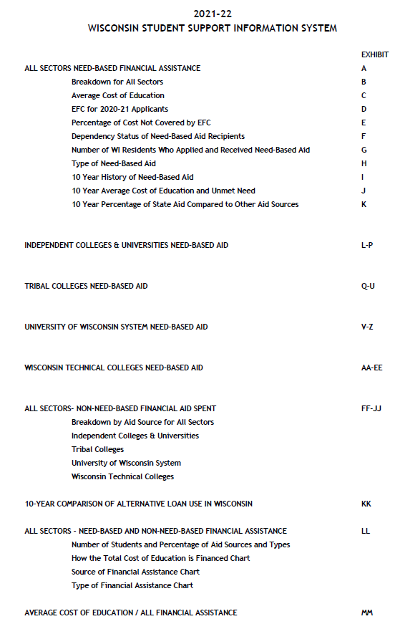
WISSIS table of Contents

Slide 24
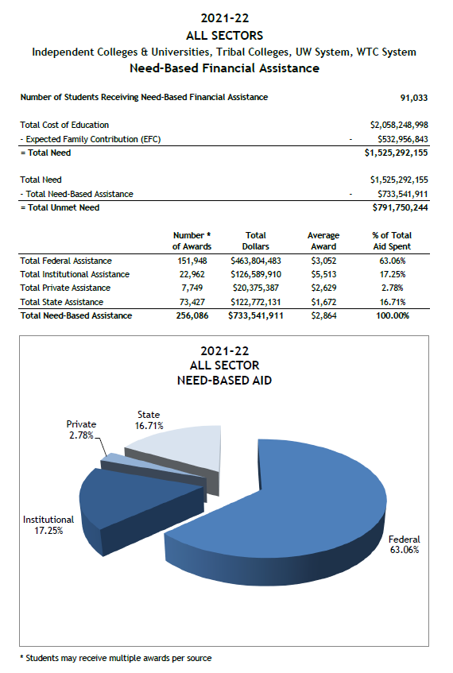
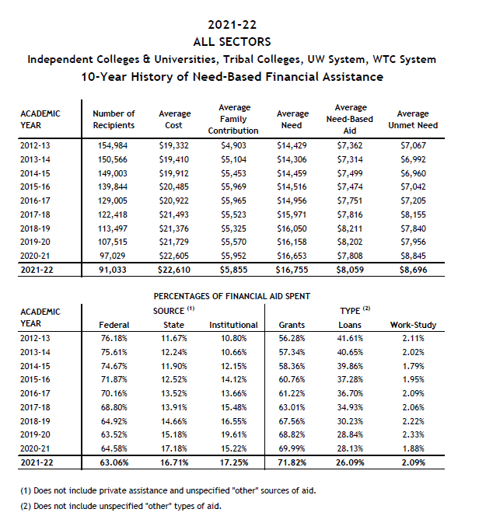
Exhibit A
Exhibit I

Slide 25
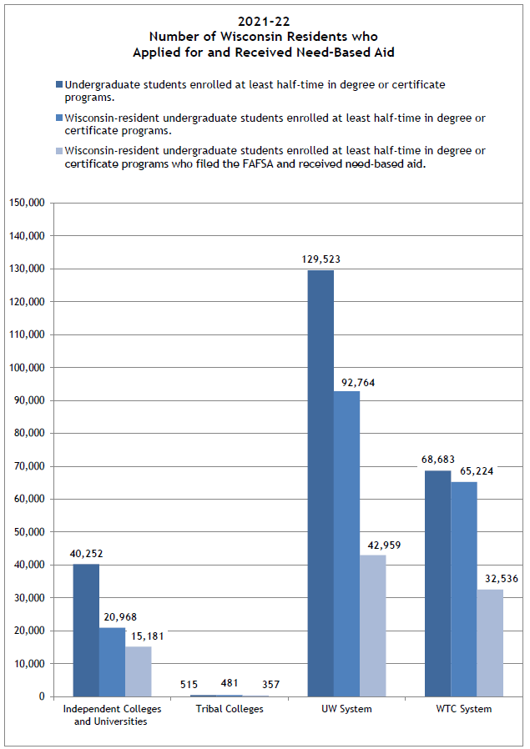
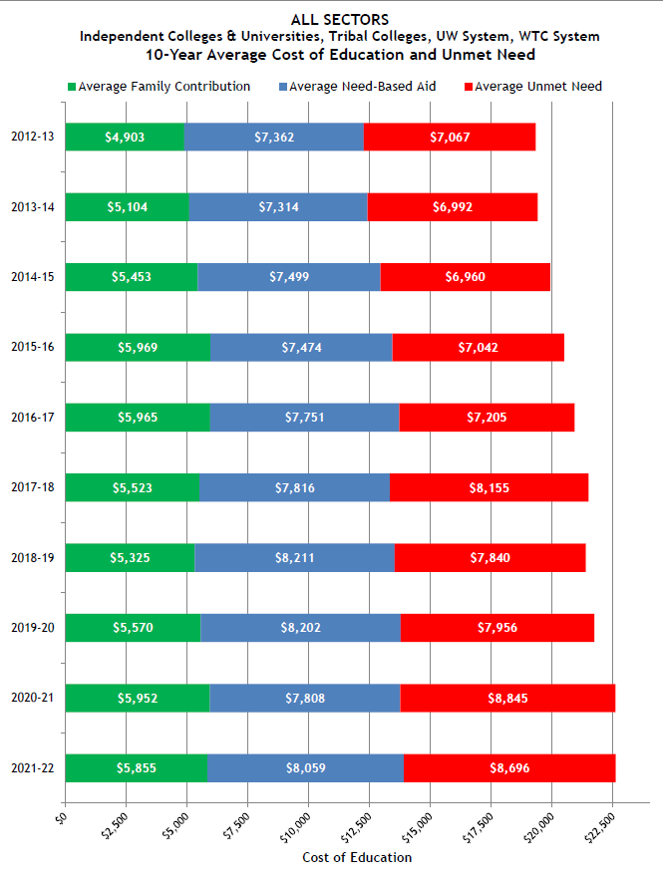
Exhibit G
Exhibit J

Slide 26
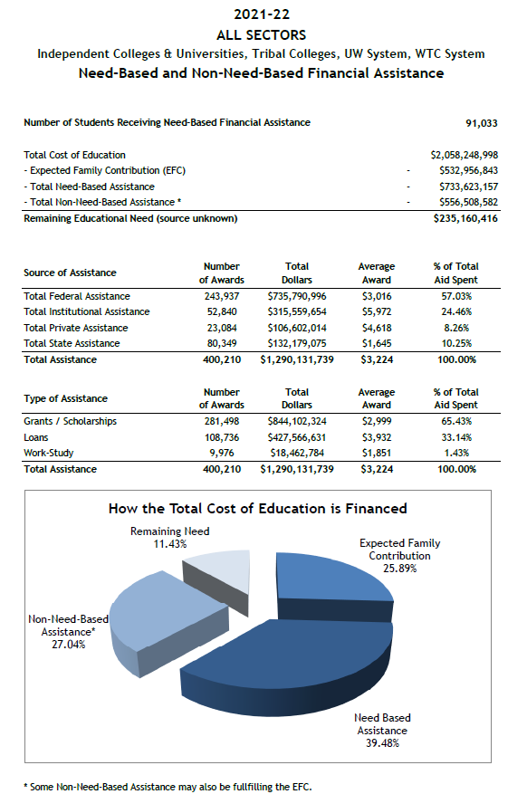
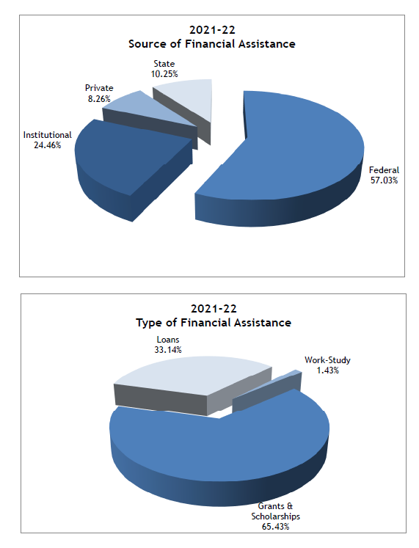
Exhibit LL

